Slide 1


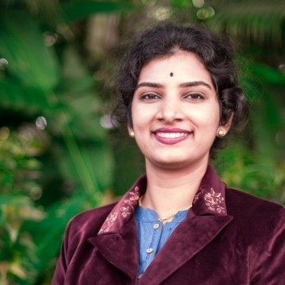




Speaker
Gowri Priya Sethuram
Gowri Priya Sethuram
Gowri Priya Sethuram
September 16th & 17th
^{Online Event}
Powered By
International Conference

